Slide 1

Getting Started with Word 2007
Information Classification: Internal Use Only

Slide 2
Objective
Create an effective and quality document using Microsoft Word 2007.

Slide 3
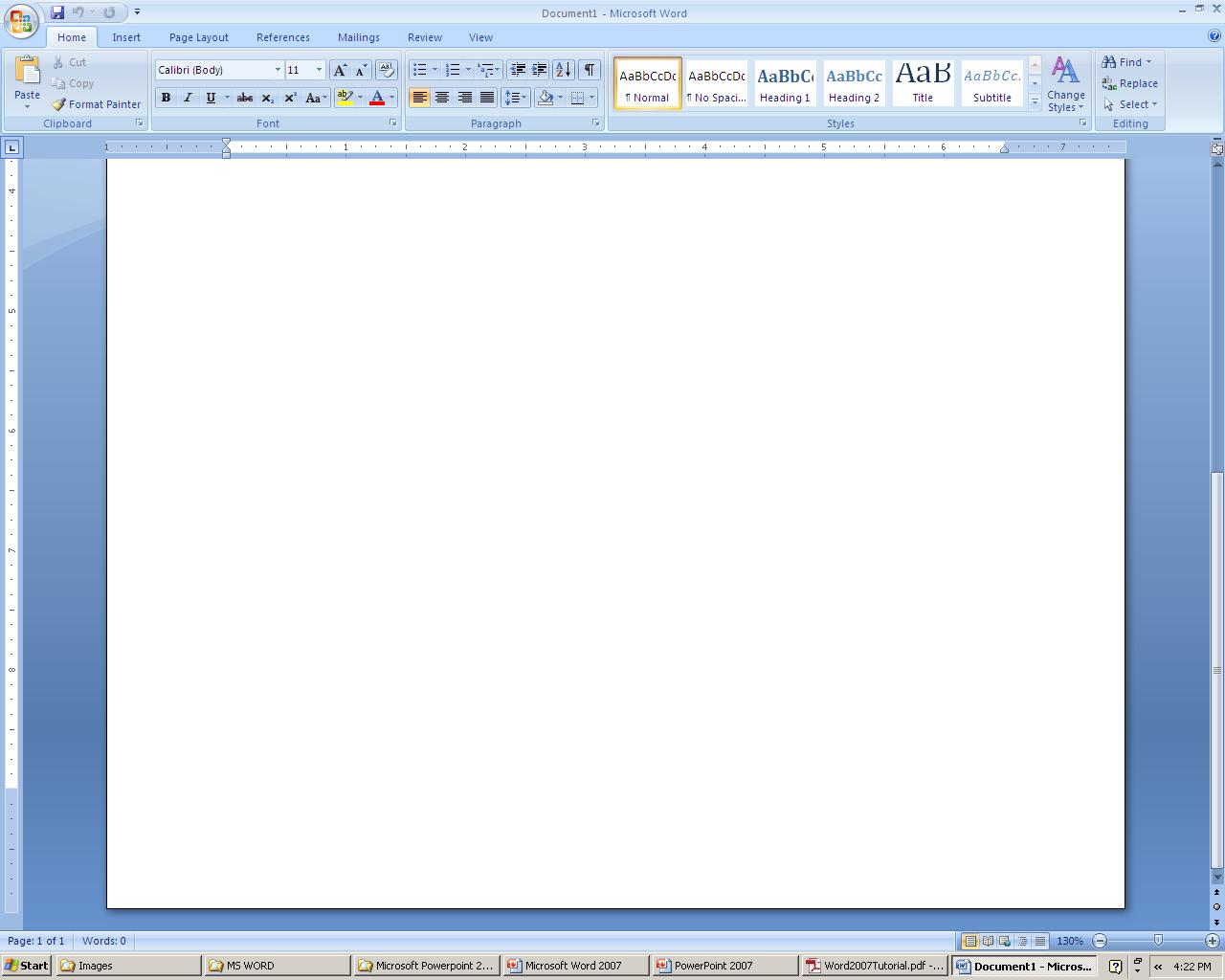
The Word Environment
To launch Word, use Start | Programs | Microsoft Office | Microsoft Office Word 2007
The Ribbon
Office Button
The Document Area.
Quick Access Bar
View Selector
Help Button.
Quick Access Toolbar
The Ribbon
Help Button
Office Button
View Selector
Document Area

Slide 4
The Word Environment contd...
Each of the tabs contains the following tools:
Home: Clipboard, Fonts, Paragraph, Styles, and Editing.
Insert: Pages, Tables, Illustrations, Links, Header & Footer, Text, and Symbols
Page Layout: Themes, Page Setup, Page Background, Paragraph, Arrange
References: Table of Contents, Footnote, Citation & Bibliography, Captions, Index, and Table of Authorities
Mailings: Create, Start Mail Merge, Write & Insert Fields, Preview Results, Finish
Review: Proofing, Comments, Tracking, Changes, Compare, Protect
View: Document Views, Show/Hide, Zoom, Window, Macros

Slide 5

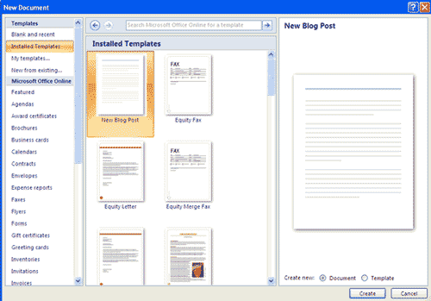
Create a New Document
There are several ways to create new documents, open existing documents, and save documents in Word:
Click the Microsoft Office Button and Click New or
or Press CTRL+N (Depress the CTRL key while pressing the “N”) on the keyboard

Slide 6
Open an Existing Document
Click the Microsoft Office Button and Click Open, or Press CTRL+O (Depress the CTRL key while pressing the “O”) on the keyboard, or
If you have recently used the document you can click the Microsoft Office Button and click the name of the document in the Recent Documents section of the window Insert picture of recent documents.

Slide 7
Saving a Document
Click the Microsoft Office Button and Click Save or Save As or
Press CTRL+S (Depress the CTRL key while pressing the “S”) on the keyboard, or
Click the File icon on the Quick Access Toolbar

Slide 8

Document Overview
There are many ways to view a document in Word.
Print Layout: This is a view of the document, as it would appear when printed. It includes all tables, text, graphics, and images.
Full Screen Reading: This is a full view length view of a document. Good for viewing two pages at a time.
Web Layout: This is a view of the document, as it would appear in a web browser.
Outline: This is an outline form of the document in the form of bullets.
Draft: This view does not display pictures or layouts, just text.
To view a document in different forms, click the document views shortcuts at the bottom of the screen or

Slide 9
Close a Document
Click the Office Button
Click Close
Editing a Document
Typing and Inserting Text – Start typing in the Document Area
Move Action | Keystroke
Beginning of the line | HOME
End of the line | END
Top of the document | Ctrl + HOME
End of the document | Ctrl + END

Slide 10
Selecting a Document
Selection | Technique
Whole word | Double-click within the word
Whole paragraph | Triple-click within the paragraph
Several words or lines | Drag the mouse over the words, or hold down SHIFT while using the arrow keys
Entire document | CTRL+A
Deselect the text by clicking anywhere outside of the selection on the page or press an arrow key on the keyboard.

Slide 11
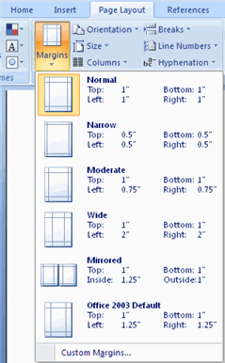
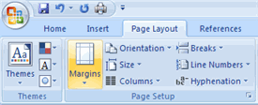
Page Formatting
Page Margins
The page margins can be modified through the following steps:
Click the Page Layout Tab on the Ribbon
On the Page Setup Group, Click Margins
Click a Default Margin, or
Click Custom Margins and complete the dialog box.
Orientations
To change the Orientation, Size of the Page, or Columns:
Click the Page Layout Tab on the Ribbon
On the Page Setup Group, Click the Orientation, Size,
or Columns drop down menus
Click the appropriate choice

Slide 12
Inserting Additional Text
Text can be inserted in a document at any point using any of the following methods:
Type Text: Put your cursor where you want to add the text and begin typing
Copy and Paste Text: Highlight the text you wish to copy and right click and click Copy, put your cursor where you want the text in the document and right click and click Paste.
Cut and Paste Text: Highlight the text you wish to copy, right click, and click Cut, put your cursor where you want the text in the document, right click, and click Paste.
Drag Text: Highlight the text you wish to move, click on it and drag it to the place where you want the text in the document.

Slide 13


Deleting Block of Text
BACKSPACE and DELETE
Search and Replace Text
To find a particular word or phrase in a document
Click Find on the Editing Group on the Ribbon
To find and replace a word or phrase in the document, click Replace on the Editing Group of the Ribbon
UNDO Changes
Click the Undo Button on the Quick Access Toolbar

Slide 14


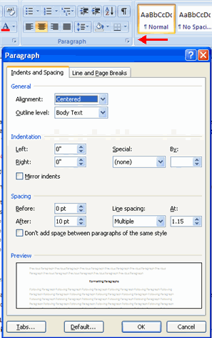


Formatting Text
Styles – Bold, Italics, Underline
Change Font Typeface and Size – Font Name, Font Size, Font Effects, Text Color, Highlight Text, Format Painter, Bullets and Numbering
Formatting Paragraph
Paragraph Alignment
Indent Paragraph

Slide 15
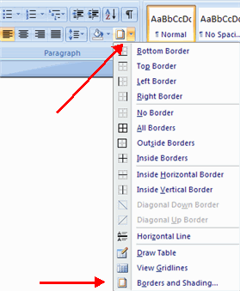
Borders and Shading
You can add borders and shading to paragraphs and entire pages. To create a border around a paragraph or paragraphs:
Select the area of text where you want the border or shading.
Click the Borders Button on the Paragraph Group on the Home Tab
Choose the Border and Shading
Choose the appropriate options

Slide 16
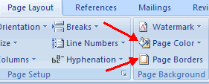
Page Borders and Color
To apply a Page border or Color:
Click the Page Layout Tab on the Ribbon
On the Page Background Group, click the Page Colors or Page Borders drop down menus

Slide 17
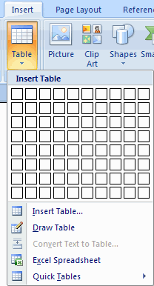
Tables
Tables are used to display data in a table format.
Create a Table
Place the cursor on the page where you want the new table
Click the Insert Tab of the Ribbon
Click the Table Button on the Tables Group. You can create a table one of four ways:
Highlight the number of row and columns
Click Insert Table and enter the number of rows and columns
Click the Draw Table, create your table by clicking and entering the rows and columns
Click Quick Tables and choose a table

Slide 18
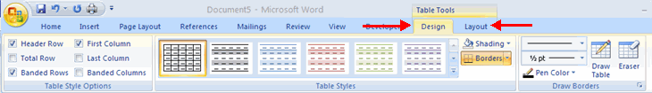
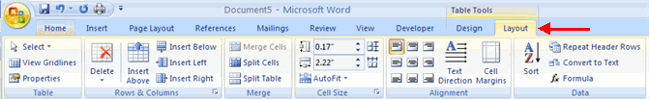
Modify a Table
Click the table and notice that you have two new tabs on the Ribbon: Design and Layout. These pertain to the table design and layout.
Layout Menu
View Gridlines and Properties (from the Table Group)
Insert Rows and Columns (from the Rows & Columns Group)
Delete the Table, Rows and/or Columns (from the Rows & Columns Group)
Merge or Split Cells (from the Merge Group)
Increase and Decrease cell size (Cell Size Group)
Align text within the cells and change text directions (Alignment Group)

Slide 19
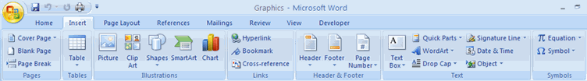
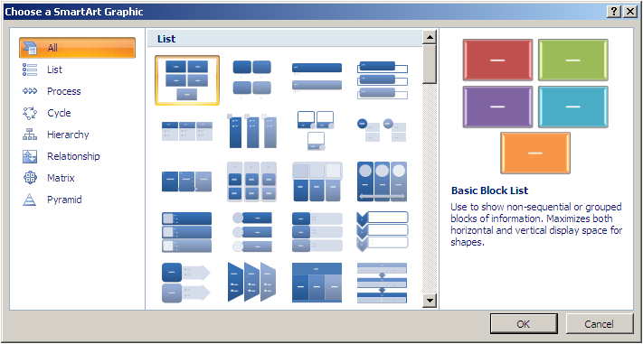
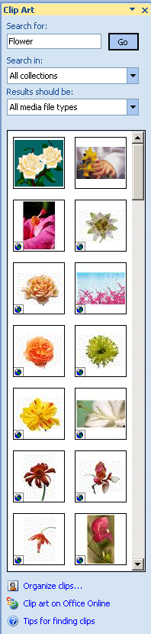
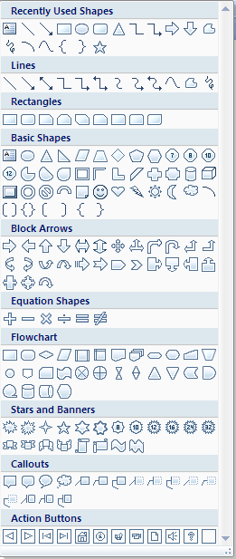
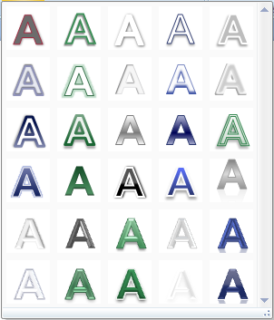
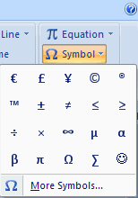
Graphics
Picture
Smart Art
Clip Art
Shapes
Word Art
Symbols and Special Characters

Slide 20
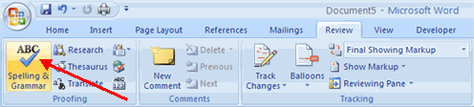
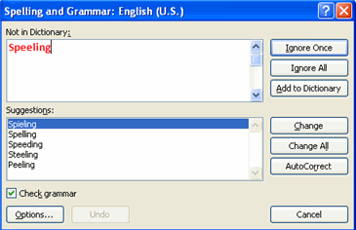
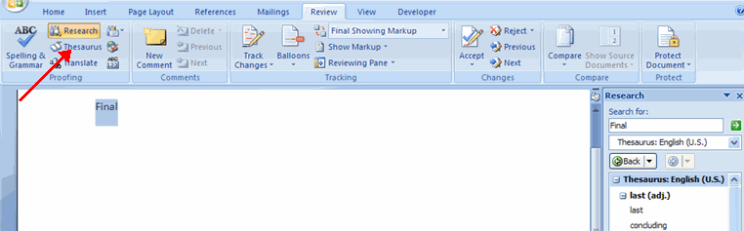
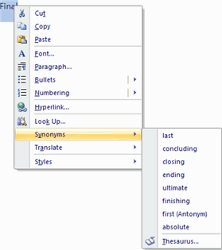
Spelling and Grammar
Thesaurus
Synonyms

Slide 21
Thank You

